Slide 1
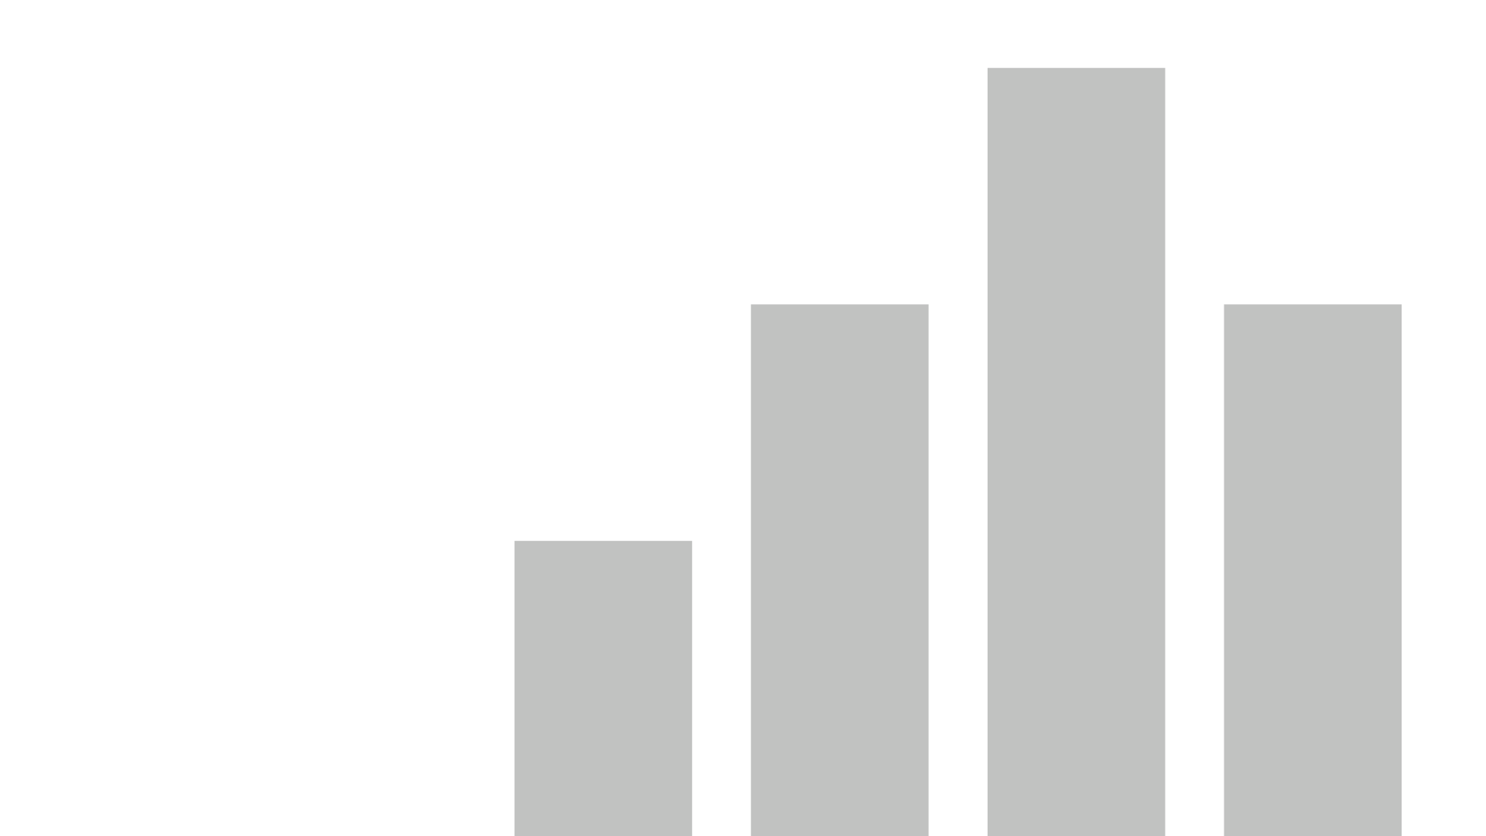


Juvenile Offenses From 1994 to 2016
View in Power BI
Last data refresh:
8/2/2021 2:40:51 PM UTC
Downloaded at:
8/2/2021 8:22:19 PM UTC

Slide 2
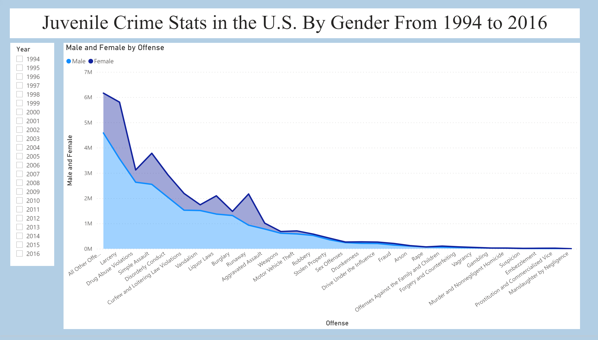
Page 1
Notes:
slicer
No alt text provided.
stackedAreaChart
No alt text provided.
textbox
No alt text provided.

